Slide 1
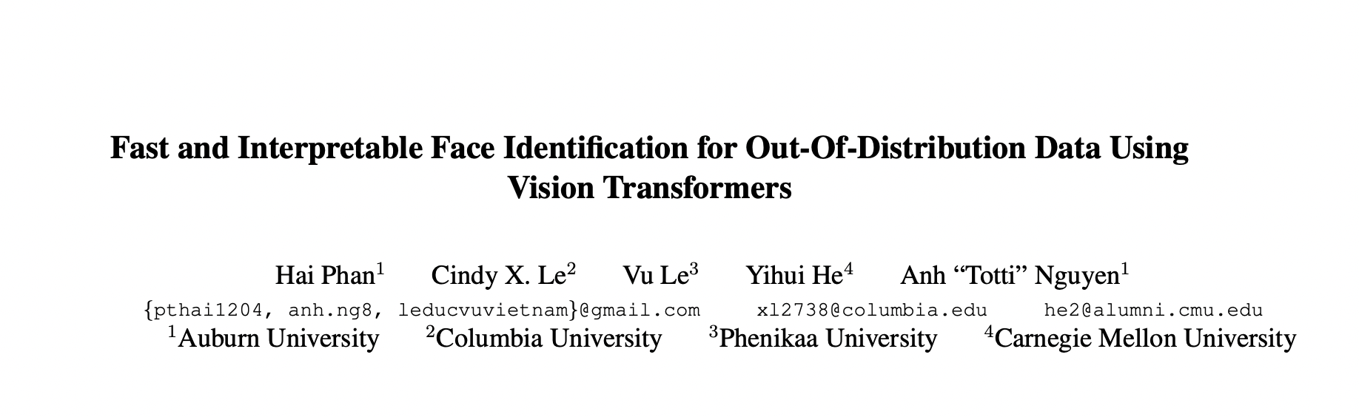

Slide 2
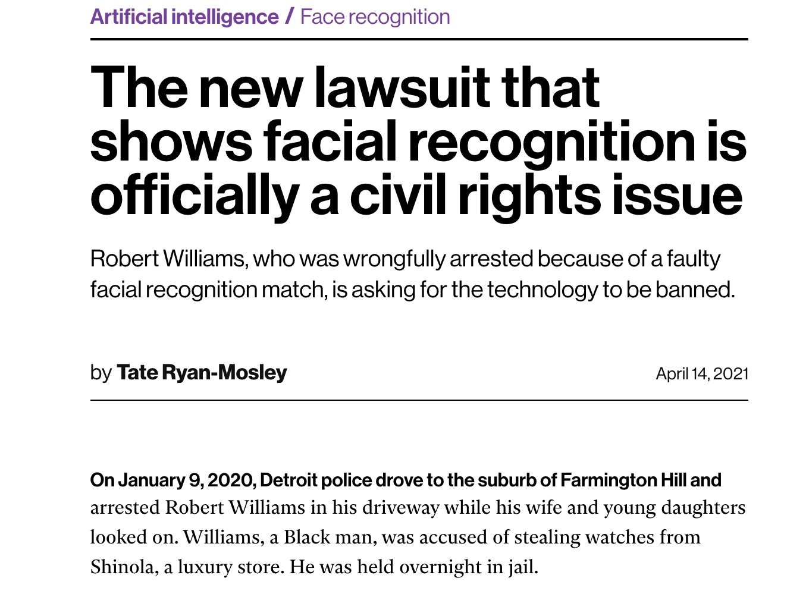
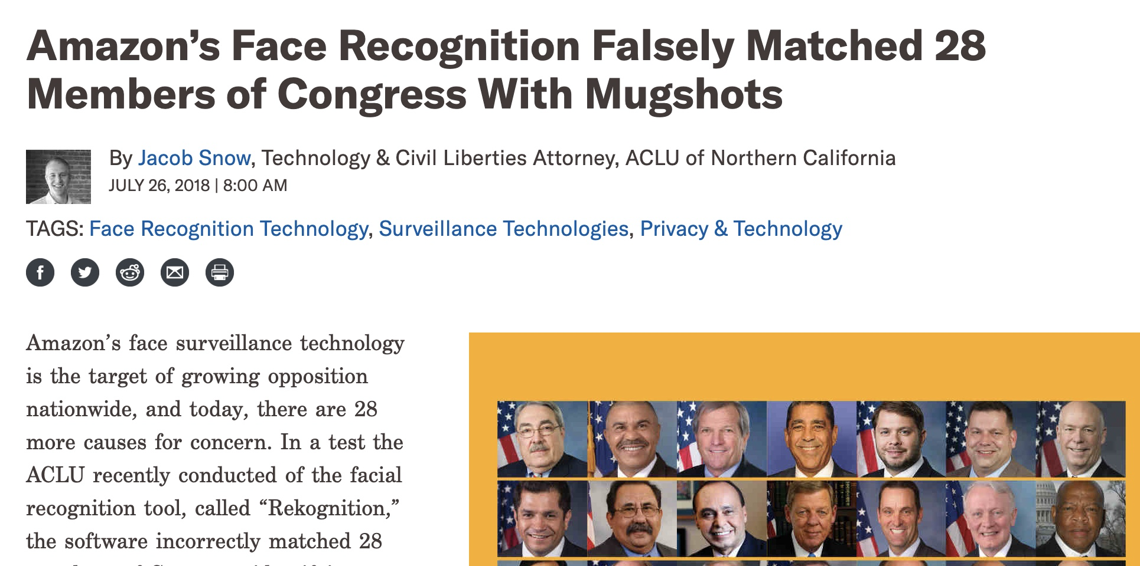

‹#›
Notes:
As we know, the face identification (FI) technology takes an important role in the real world, including law enforcement [18, 43, 44], private businesses [2], smartphones [19], and so on.

Slide 3
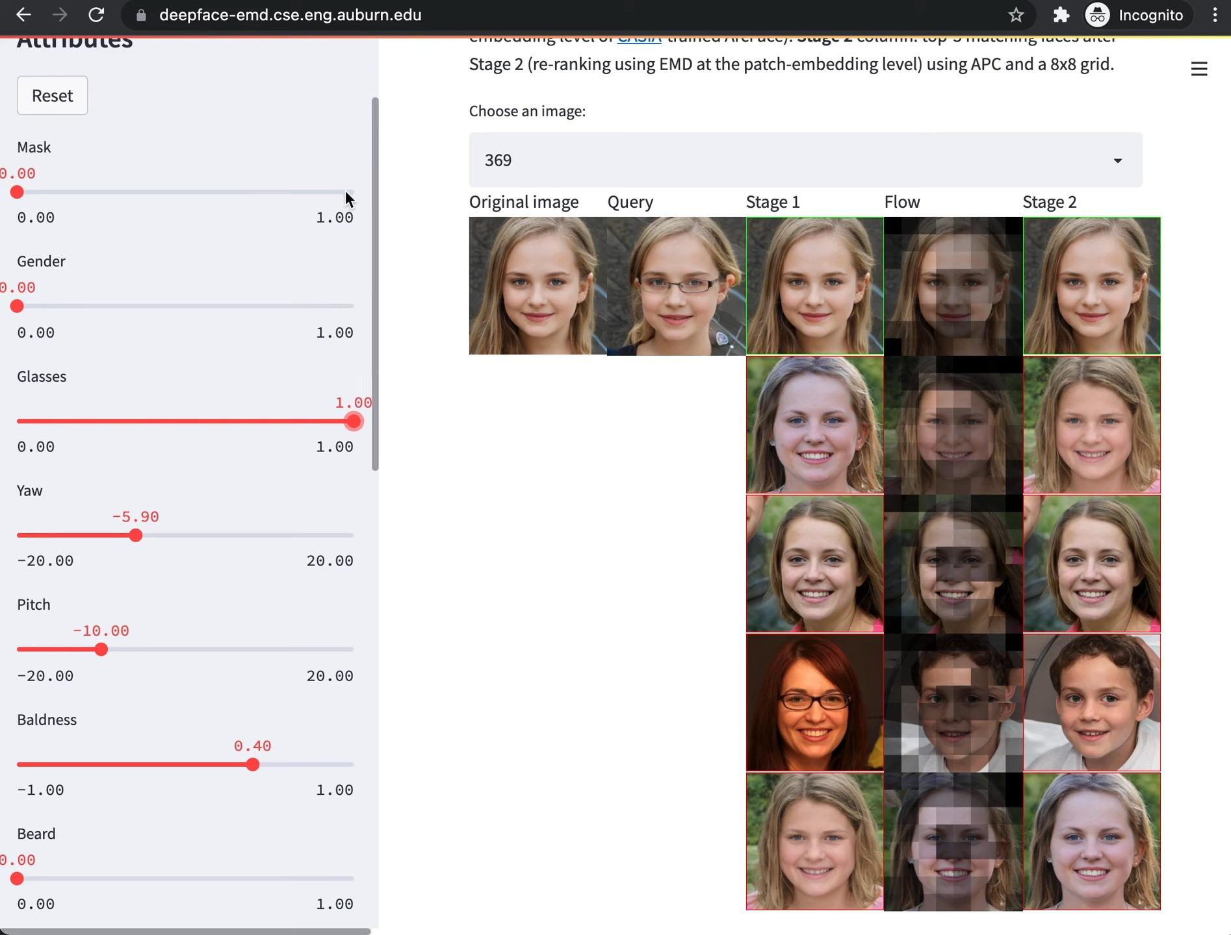
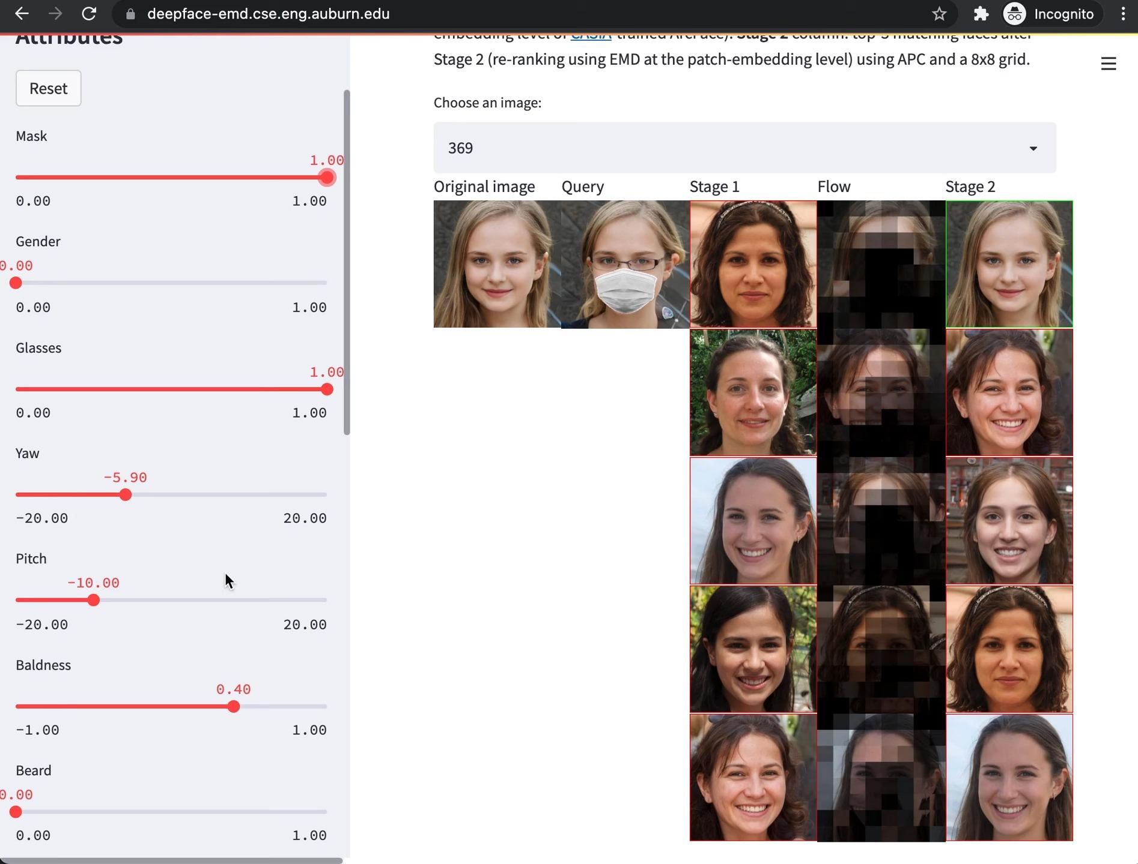
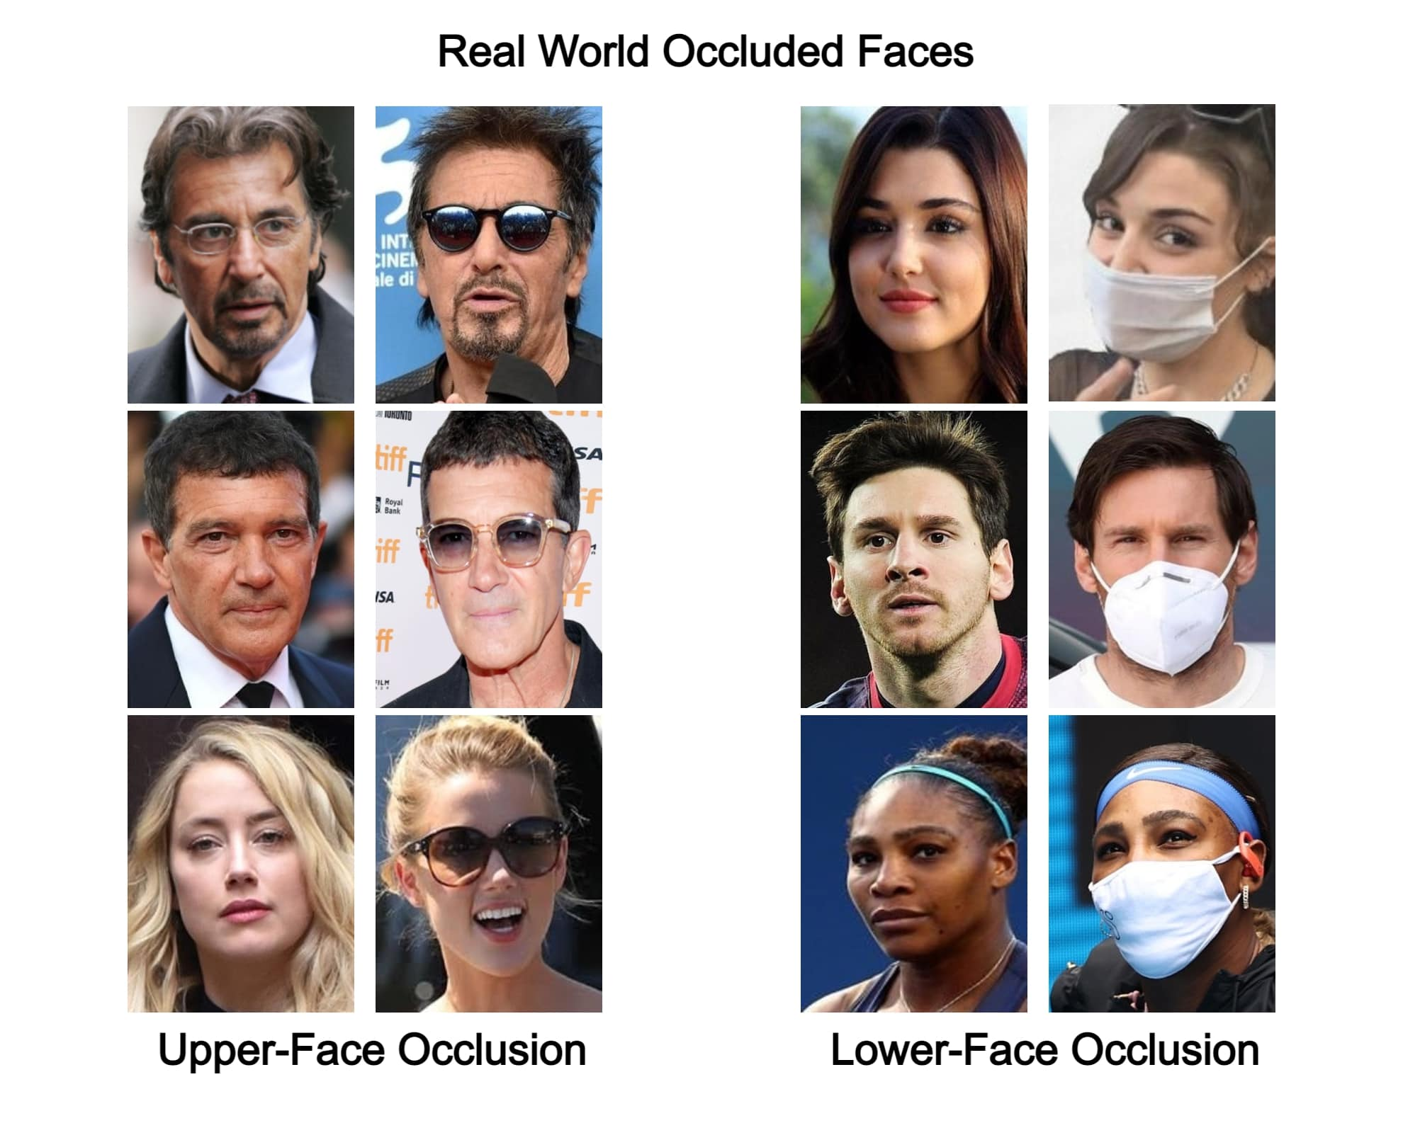
Motivation
Masked
98.41%
P@1 on LFW
39.79%
P@1 on MLFW
Image source: https://paperswithcode.com/dataset/rof
Notes:
The research problem can be formulated as, to identify a person in a query image by ranking all gallery images based on their pairwise similarity.
Unfortunately, image inputs are not always obtained in ideal conditions and sometimes we have faces with masks, sunglasses, or other adversarial components. The accuracy can drop sharply from 98% to only 40% for such out-of-distribution data (OOD).

Slide 4
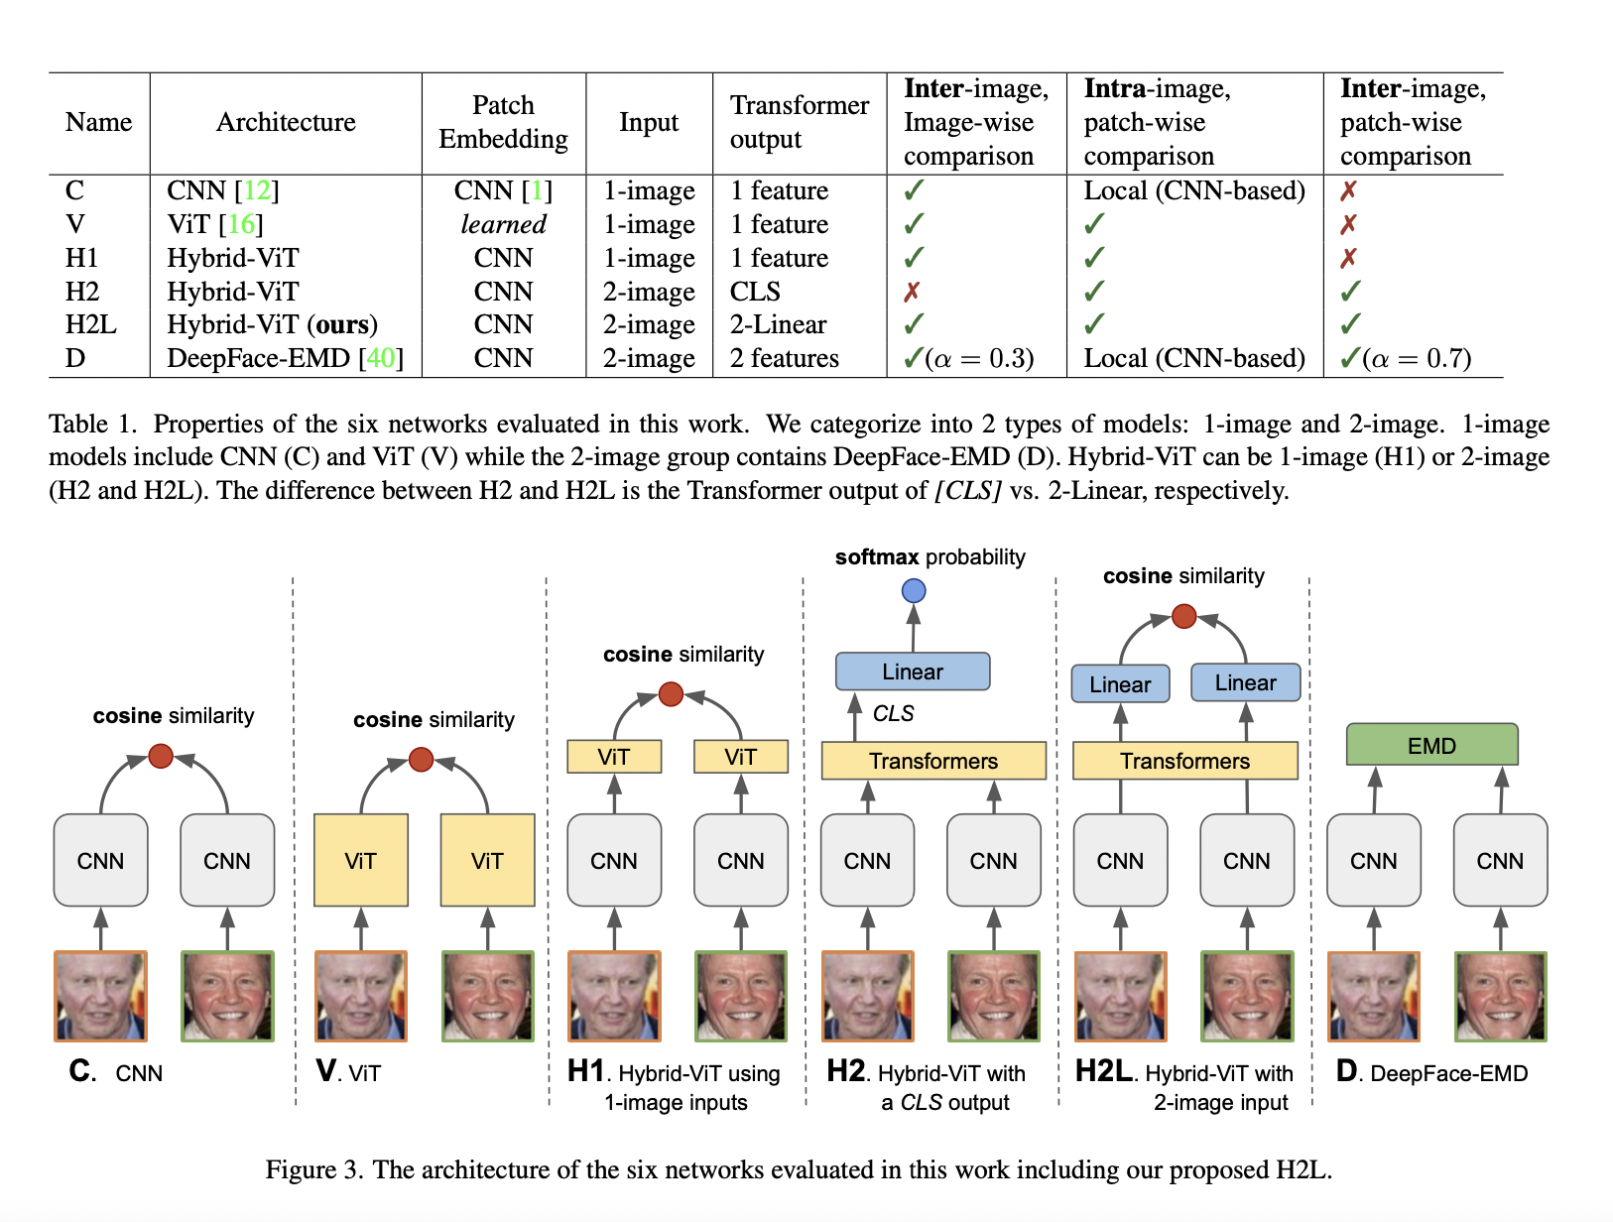
Related Work
Notes:
Previous deep learning approaches typically adopt a CNN architecture to extract features explicitly and then use metric learning methods. For example, the recent SOTA, DeepFace-EMD, used the Earth Mover’s Distance to obtain cross-image information from CNN outputs.

Slide 5
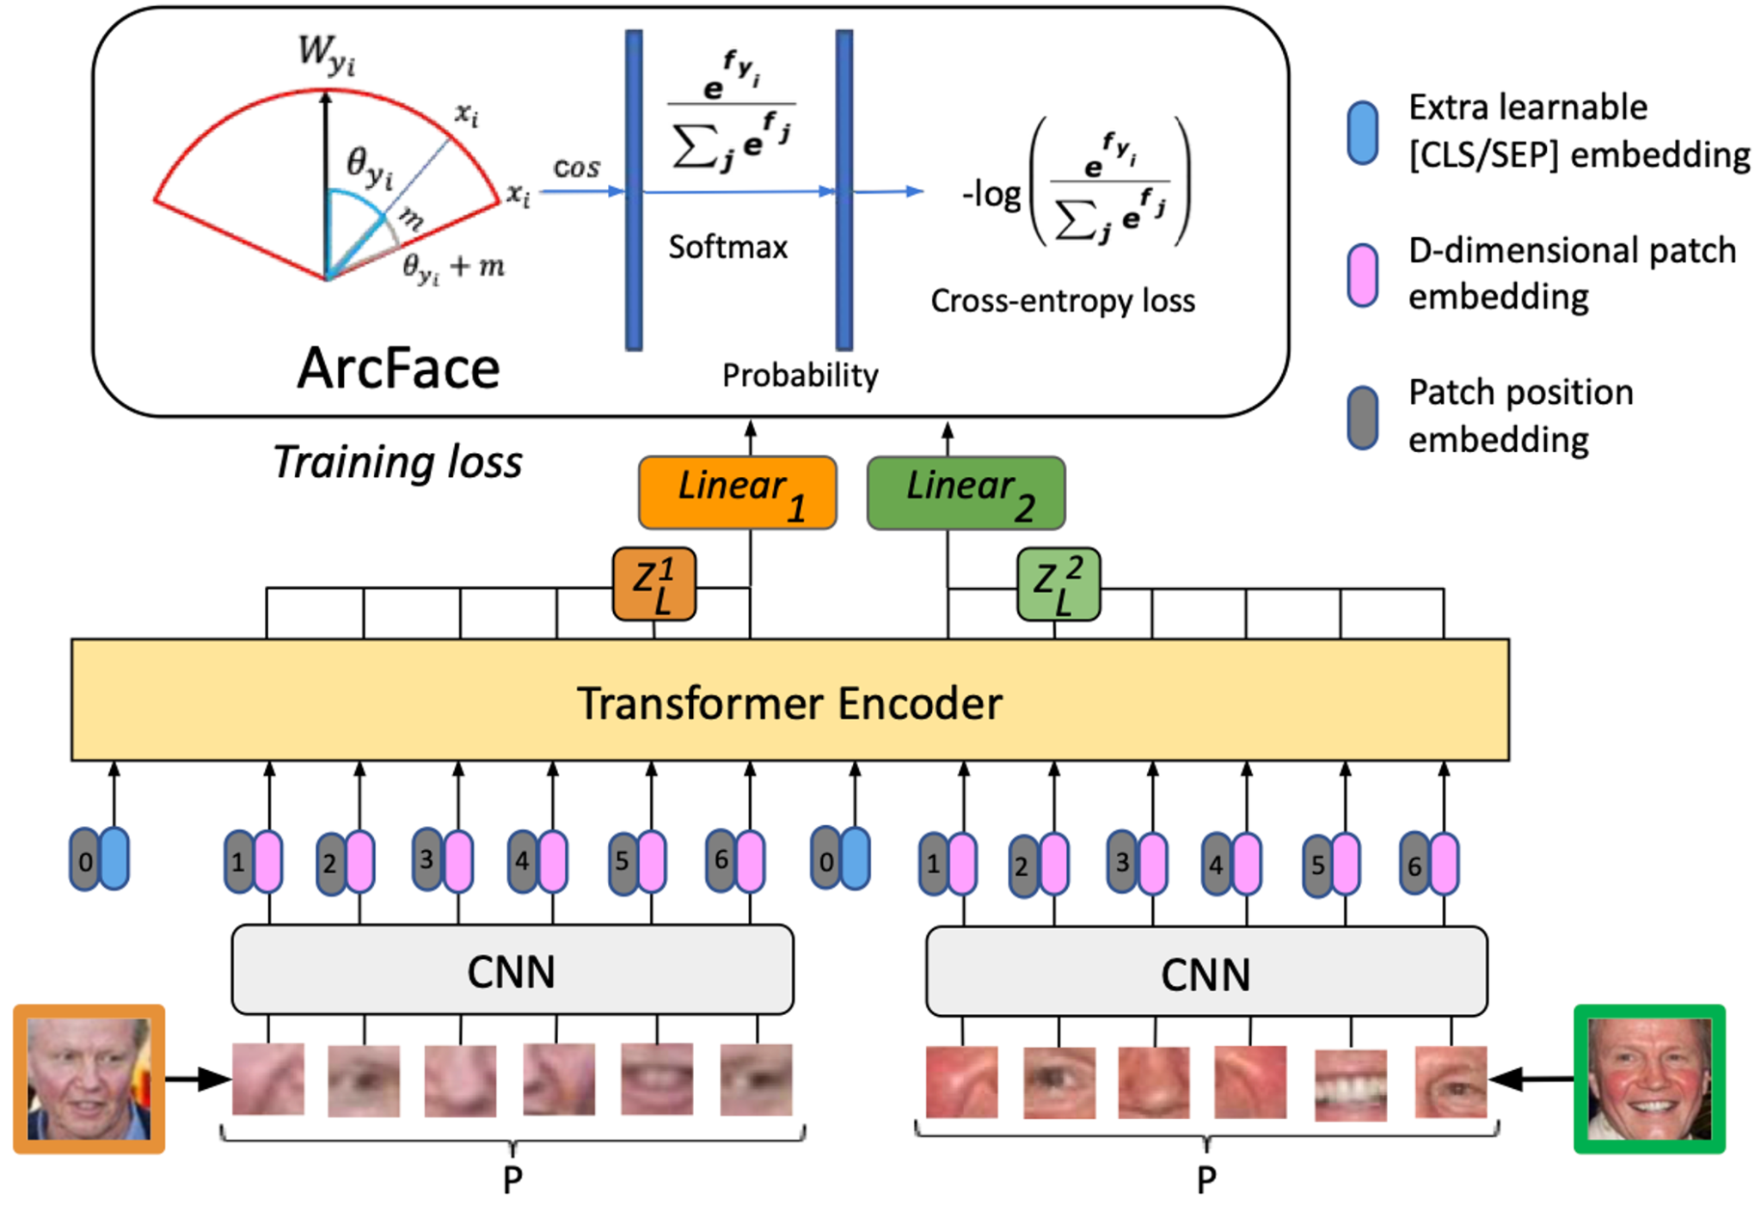
Proposed ViT-based Architecture
Input: patch embeddings from a pre-trained CNN (ArcFace)
The transformer encoder: multi-headed self-attention and MLP layers
ArcFace loss to separate and learn cross-image margins
Notes:
In this paper, we propose a novel ViT architecture. It takes in patch embeddings from a pre-trained CNN, ArcFace [12]. The Transformer encoder consists of a block of a multi-headed self-attention (MSA) layer and an MLP layer.
See the architecture graph, the blue little parts are extra learnable embeddings, or CLS. And the pink and grey ones are just part of the typical transformer structure. The layers of the Transformer encoder contain both self-attention and cross-attention from 2 input images. After that, the patch embeddings of the input images go through two linear layers.
On the top of the graph, similar to some previous methods, we use the ArcFace as our loss function [12] to separate and learn cross-image margins to their corresponding labels.

Slide 6
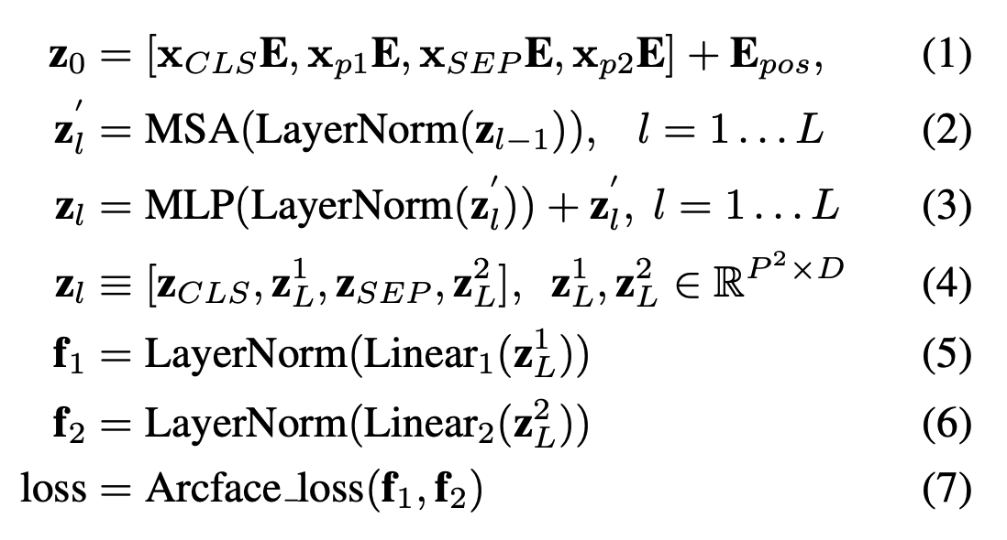
Formulation
https://arxiv.org/abs/2311.02803
Notes:
For more information on our formulation, welcome to check our original paper.

Slide 7
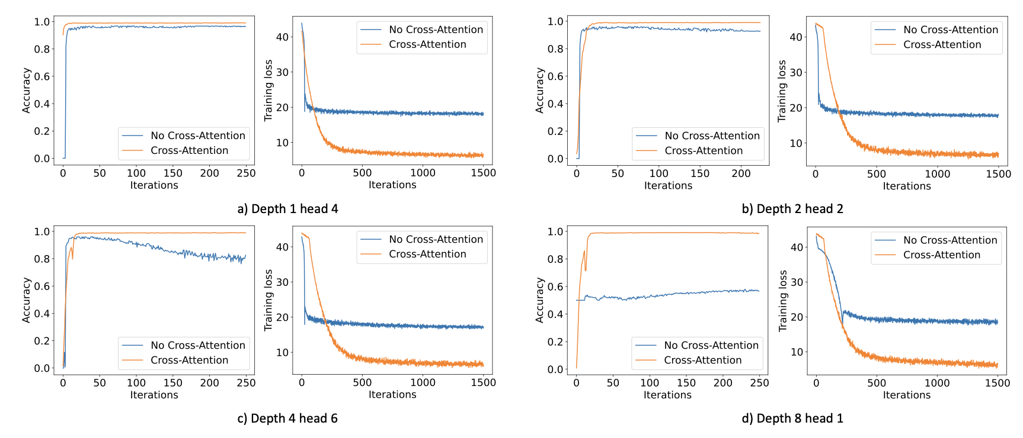
Ablation Studies

Slide 8
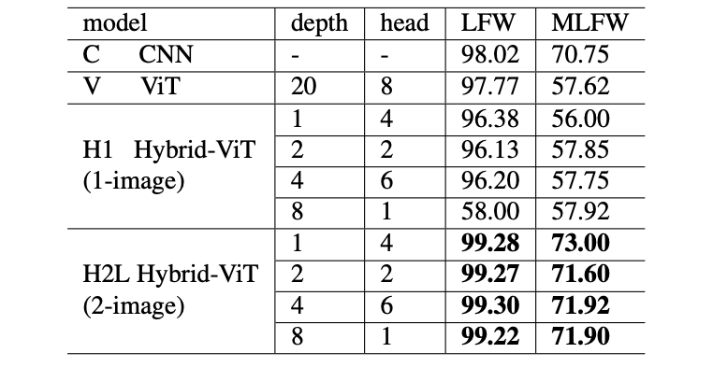
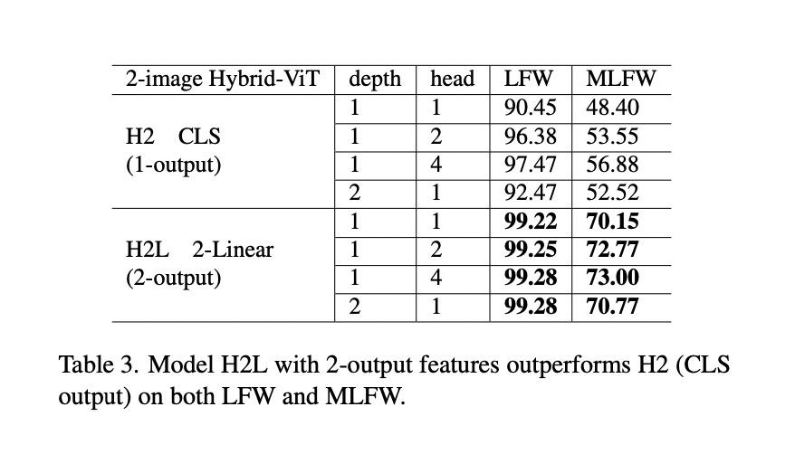
Ablation Studies
Cross-attention 2-image vs. no cross-attention 1-image
2-output linear vs. 1-output [CLS], both with cross-attention
Notes:
Before running the main experiments, we conducted two ablation studies for model understanding and parameter selection. (1) Cross-attention 2-image vs. no-cross-attention 1-image, for both in-distribution data and OOD. and (2) 2-output linear vs. 1-output [CLS], both with cross-attention.
Results show that, for the 1st study, the cross-attention 2-image performs better, whereas for the 2nd study, the 2-output linear performs better.
Then we selected the best settings from our ablation studies and trained our model on the popular CASIA Webface [58] dataset.

Slide 9
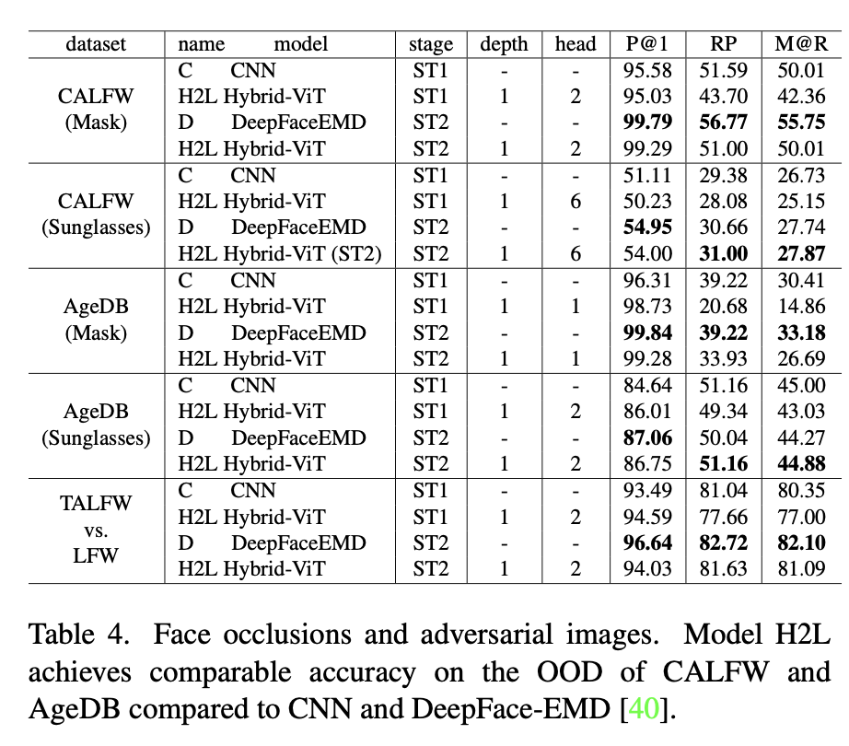
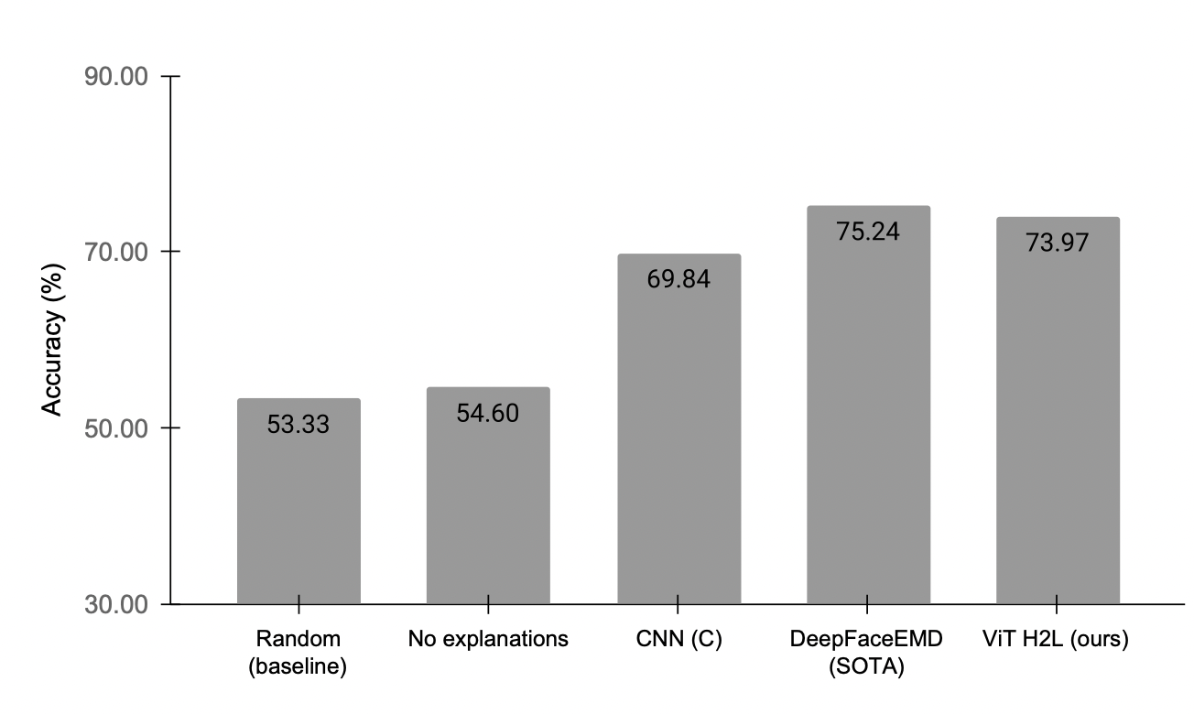
Results - Comparable Accuracy to SOTA
Notes:
Here comes our main results. First, we achieved comparable performance to the SOTA DeepFace EMD, with an accuracy of 73.97%.

Slide 10
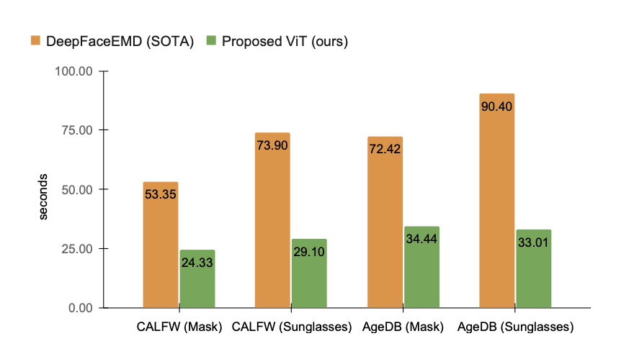
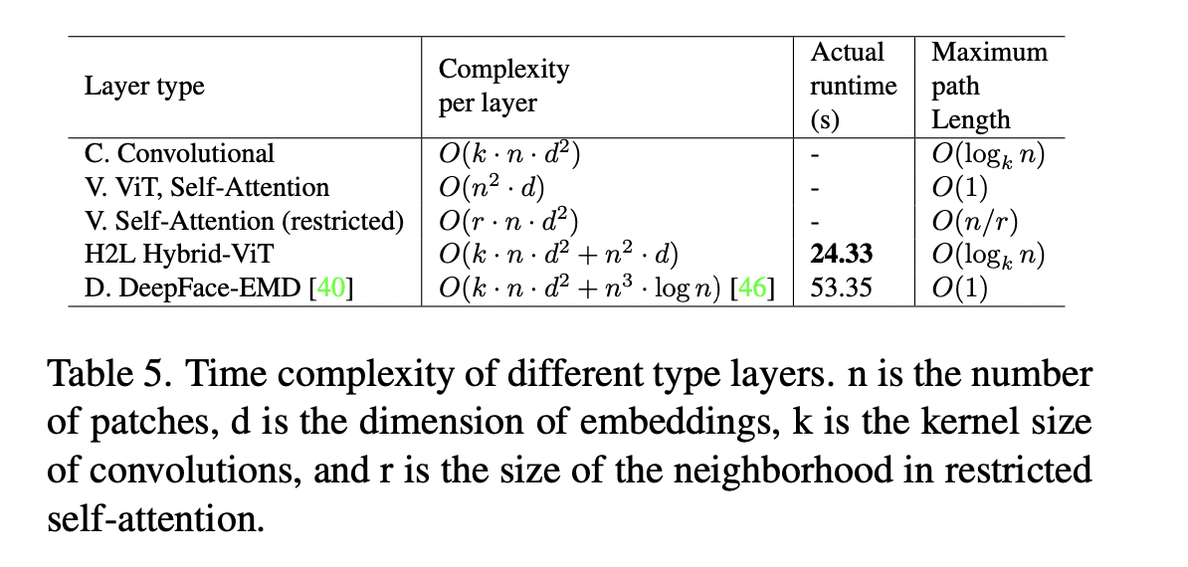
Results - Faster Inference
Notes:
On top of that, our ViT model runs more than two times faster than the SOTA in practice, as shown in the figure. We provided a time complexity analysis, shown in the chart, of why our method runs faster from a theoretical perspective. Faster inference speed can be really helpful for facial recognition applications in the real world.

Slide 11
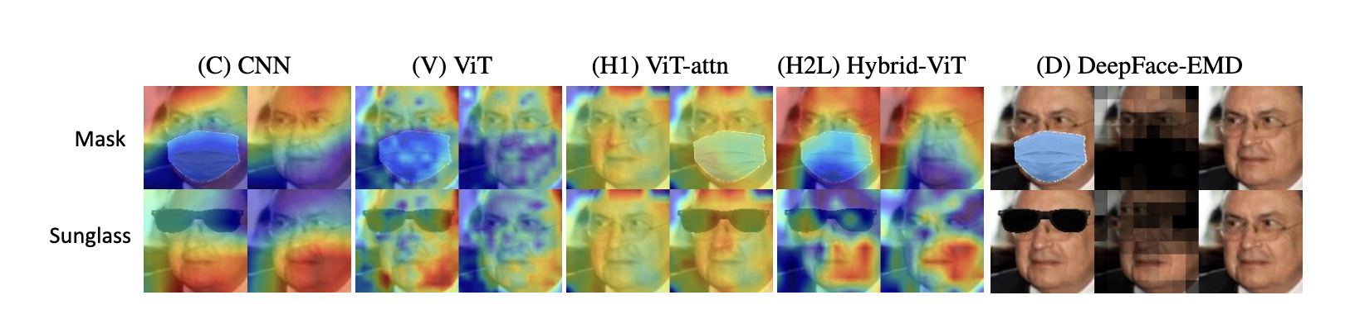
Results - More Explainable
54.60%
No explanation
73.97%
With H2L explanation
Notes:
Our model also showed a good explainability. We visualized the attention heatmap using the method of Chefer and conducted a user study of 21 participants. We find that users without any model explanation score an average accuracy of 54.60%, and this number jumps up to 73.97% when users are provided with the heatmap from our model.

Slide 12
Significance
To our knowledge, our work is the first to
explore the design space of ViTs for the facial identification problems on out-of-distribution data;
compare ViT-based and EMD-based image similarity approaches; and
study how visual explanations improve human accuracy in face verification.

